Slide 1


BMI , Smoking, and Health Insurance Costs
Feifei Li, Izzy Mika
STAT 311 Regression Analysis, Fall 2025
Dataset: Kaggle "Insurance Charges"
Presentation Date: Dec 2, 2025

Slide 2


Motivation & Context
U.S. Healthcare Costs
U.S. healthcare costs are highly variable
Known Cost Drivers
Smoking and obesity are known cost drivers
Key Question
Does BMI affect smokers differently than non-smokers?
Stakeholders
Important for insurers, policy makers, and public health

Slide 3
Research Questions
1
Primary Influence Factors
2
Interaction Effects
3
Model Transformation
Does BMI affect charges differently for smokers vs. non-smokers?
Does log-transforming charges improve model adequacy?
How do age, BMI, number of children, and smoking status influence annual medical charges?

Slide 4
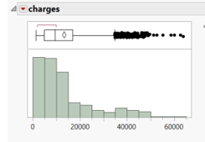
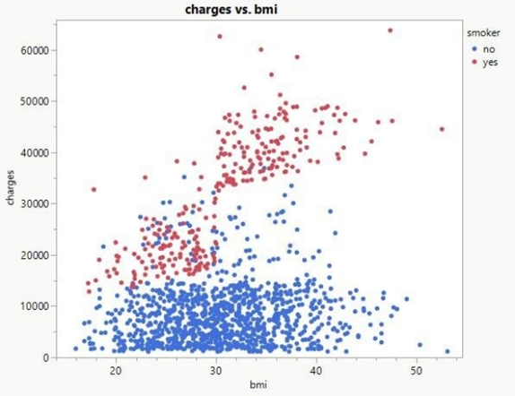
Dataset Overview
1,338 observations; 1,335 after removing missing values
Strong right-skew in charges → motivates log transform
Variables:
Quantitative
Qualitative
age
sex
BMI
smoker (baseline = smoker=yes)
children
region
charges
Exploratory patterns suggest a BMI × Smoker interaction ->

Slide 5
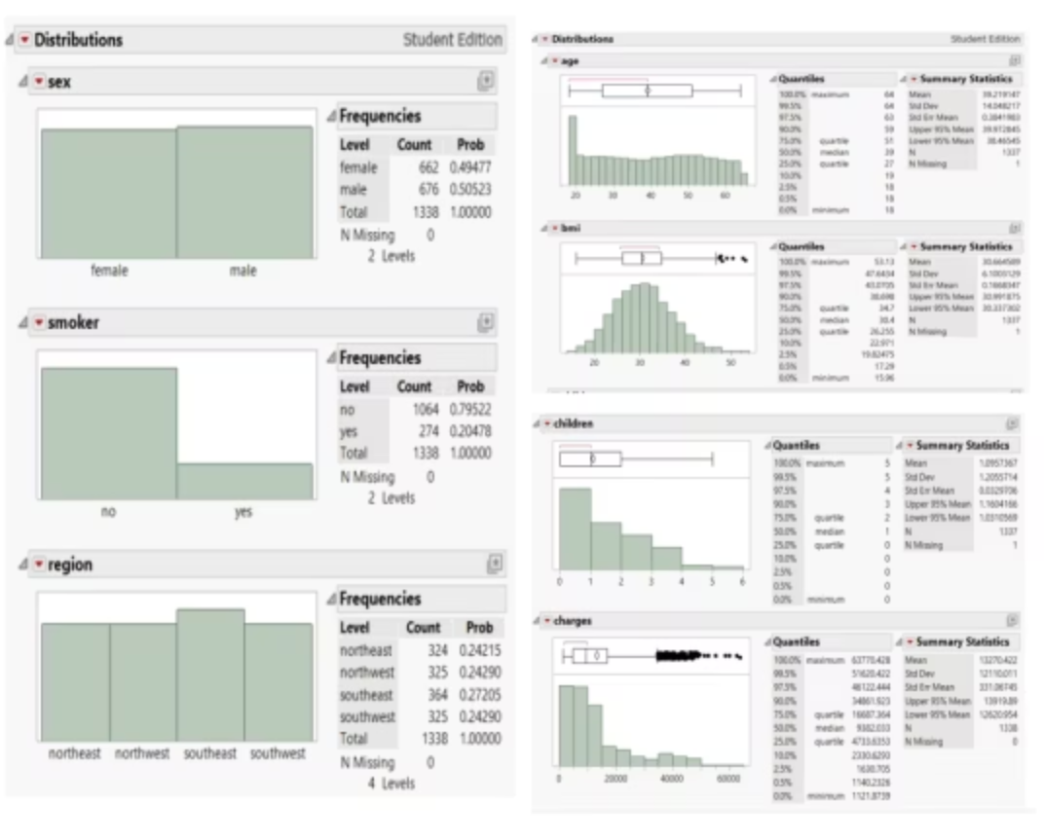
More details from EDA
Age: adult range, mild right skew BMI: right-skewed, natural high-BMI outliers
Children: mostly 0–2
Charges: long tail → violates assumption of normality
Variable | Mean | Std. Dev | Min | Max
age | ~39 | ~14 | 18 | 64
bmi | ~30.7 | ~6.2 | 15.96 | 53.13
children | ~1.09 | ~1.21 | 0 | 5
charges | ~13,270 | ~12,110 | 1,122 | 63,770

Slide 6
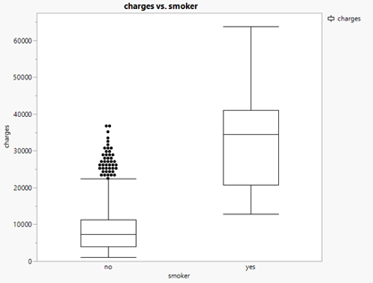
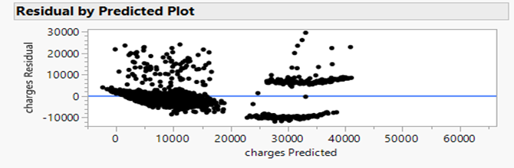
Boxplot: charges by smoker
Exploratory Data Analysis (Graphs)
Key observations:
Smoker Costs
BMI x Smoker Relationship
Health Insurance Costs for Smokers is much more expensive
BMI–Charges increase, but much less than when someone smokes.
Two distinct clusters - one jumps in costs when an individual both smokes and has a BMI >= 30 (classified as obese). Suggests an interaction.

Slide 7
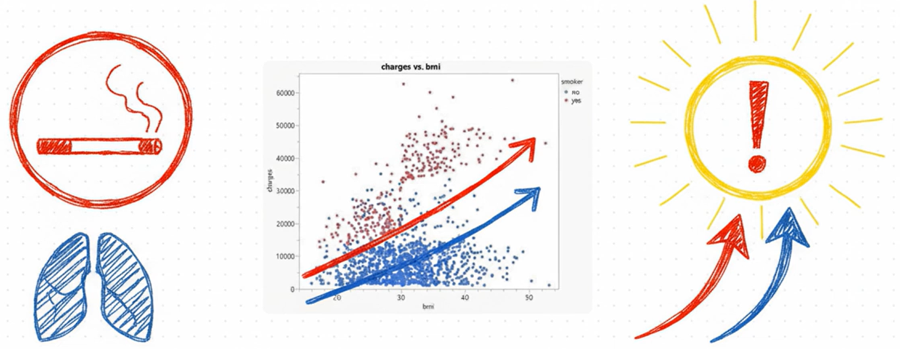

Slide 8
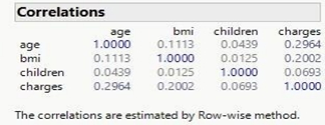

Multicollinearity Check
Correlation (weak):
age–BMI = 0.11
BMI–children = 0.01
age–children = 0.04
VIF Table:
Predictor
VIF
age
1.0152
bmi
1.0126
children
1.0021
smoker
1.0009
Interpretation: No multicollinearity → stable coefficient estimates

Slide 9
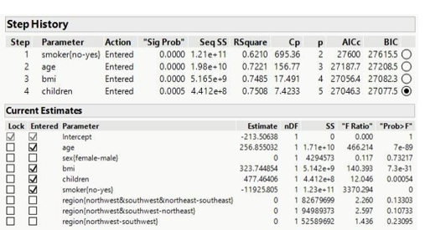
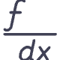
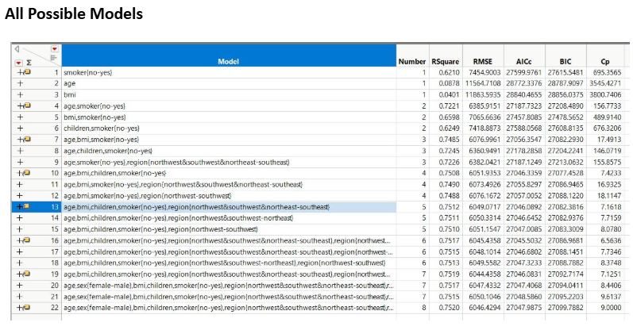

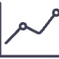
Variable Screening & Model Building
Stepwise and all-possible-models screening identified age, BMI, children, and smoker status as core predictors. Sex and region were rejected.
Model 1: Main Effects
Evaluated E(y) = β₀ + β₁age + β₂bmi + β₃children + β₄smoker.
Model 2: Interaction Model
Added BMI × smoker interaction to Model 1: E(y) = ... + β₅(bmi × smoker).
Model 3: Log-Transformed
Modeled ln(charges) to correct heteroscedasticity and non-normality, as indicated by Box–Cox (λ ≈ 0).

Slide 10
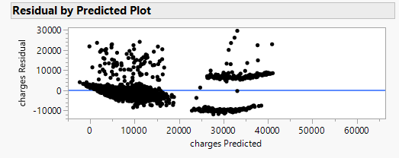
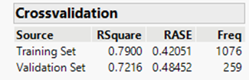
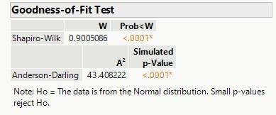
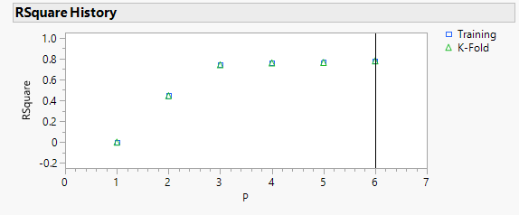
Methods – Model Building
Three nested regression models:
Model 1
Model 2
Model 3
Main effects
Add BMI × smoker interaction
Log-transform charges + interaction
Diagnostics run:
Residual vs Predicted
Q–Q plot
Cook's Distance
Shapiro–Wilk
Box–Cox (λ ≈ 0)
Train/test split (80/20)
PRESS statistic

Slide 11
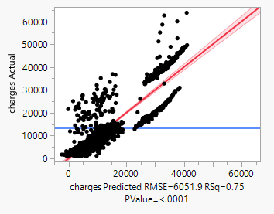
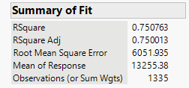
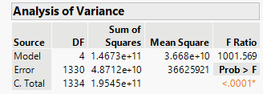
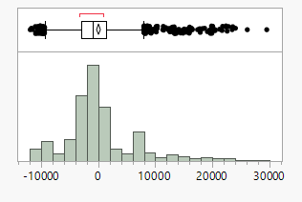
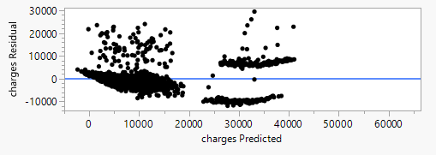
Model 1 Results (Main Effects)
Equation
Key results:
All predictors significant
Smokers +$23,852 higher charges
Adjusted R² = 0.7508; CV = 45.66%
Issues:
Severe heteroscedasticity
Strong right-skew
Two-band residual pattern → missing interaction
(JMP residual plot screenshot here)

Slide 12
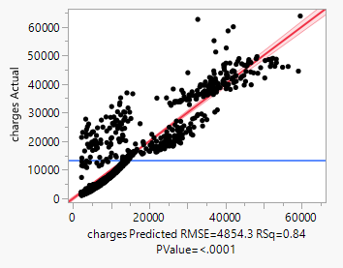
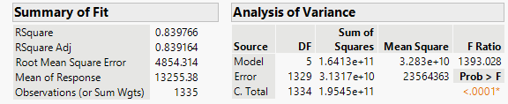
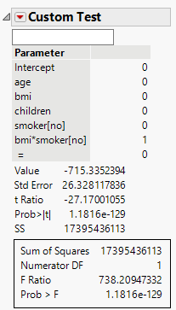
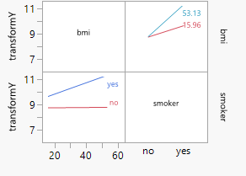
Model 2 Results (Interaction Model)
Equation includes BMI × smoker
ŷ = -22847.84 + 264.00987x₁ + 1438.6853x₂ + 513.60664x₃ + 20065.293x₄ - 1430.67x₂x₄
Key insights:
Smokers BMI slope ≈ 1438
Non-smokers BMI slope ≈ 8
Adjusted R² = 0.8392 Improvement from Model 1
Partial F-test: F = 738.21, p ≈ 1.18×10⁻¹²⁹ → interaction required
Interaction highly significant (p < .0001)

Slide 13
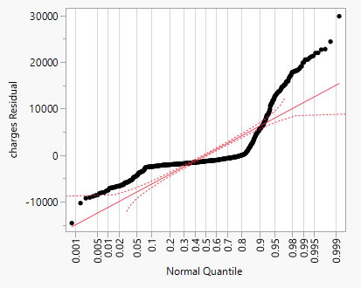
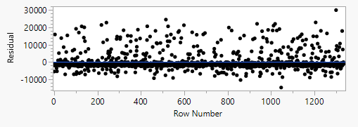
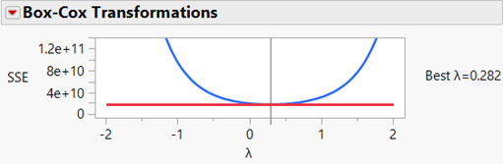
Model 2 Results (Interaction Model)
Issues:
Still heteroscedastic
Still non-normal
Box–Cox suggests log transform ln(Charges) since λ closest to 0

Slide 14
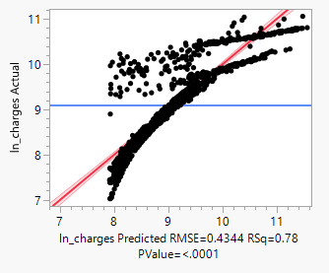
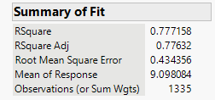
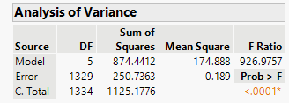
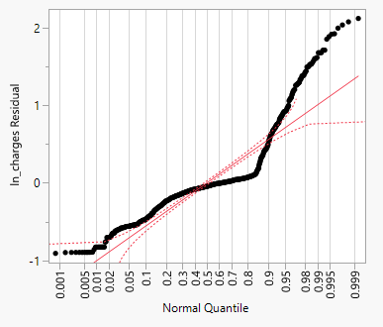
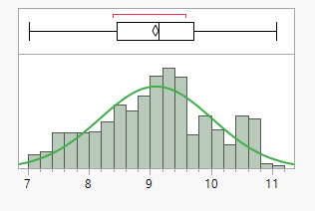
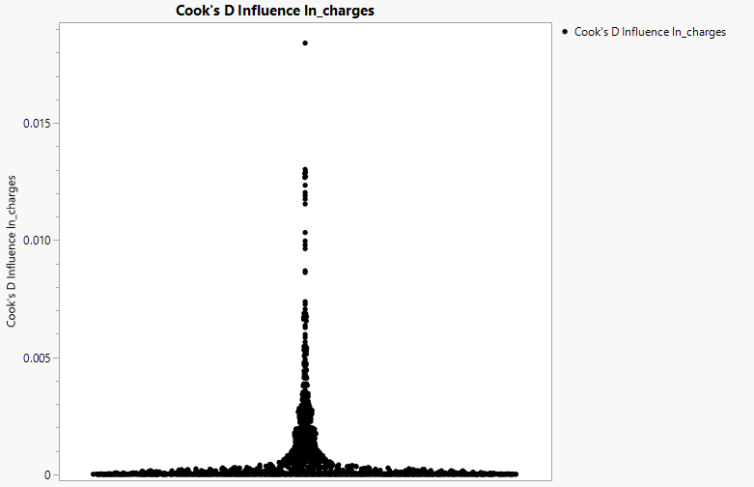
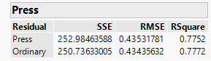
Model 3 Results (Log-Transformed Model)
Log Model:
Percent-change interpretations:
Age: +3.5% per year
BMI (smokers): +4.5% per BMI
BMI (non-smokers): +0.1% per BMI
Children: +10% per child
Smoker main effect: insignificant
Interaction: BMI effect much stronger for smokers
Performance:
4.77%
0.7752
Cross-Validation
PRESS R²
Dramatic improvement
Strong predictive power
Residuals nearly symmetric
No influential points

Slide 15
Model Comparison Table
Metric | Model 1: Main Effects | Model 2: Interaction | Model 3: Log-Transformed
Equation Form | Linear | Linear + BMI×Smoker | Log-linear + BMI×Smoker
Adjusted R² | 0.7508 | 0.8392 | 0.776 (log scale)
RMSE | 6052 | 4854 | 0.434
CV (Prediction Error) | 45.66% | 36.6% | 4.77%
Skewness & Normality | Severe skewness, non-normal | Still skewed, non-normal | Nearly normal residuals
Constant Variance | Violated | Violated | Greatly improved
Outliers/Influential | None severe | None | None
Interpretation Quality | Moderate | Strong | Strongest (percent changes)
Overall Fit | ❌ Poor | ⚠️ Better | ✅ Best
Final Choice? | No | No | Yes

Slide 16
Final Model Selection
Why Model 3 is best:
Fixes skewness
Stabilizes variance
Addresses non-normal distribution in the response variable.
Ensures consistent error variance across the range of predictors.
Captures BMI × smoker interaction
Best predictive accuracy
Accurately models the combined effect of BMI and smoking status.
Outperforms other models in predicting outcomes.
Passes diagnostics
Generalizes well (train/test, PRESS)
Meets assumptions for linear regression, ensuring reliability.
Demonstrates strong performance on unseen data and robust cross-validation metrics.
Model 3 is the final selected model.

Slide 17
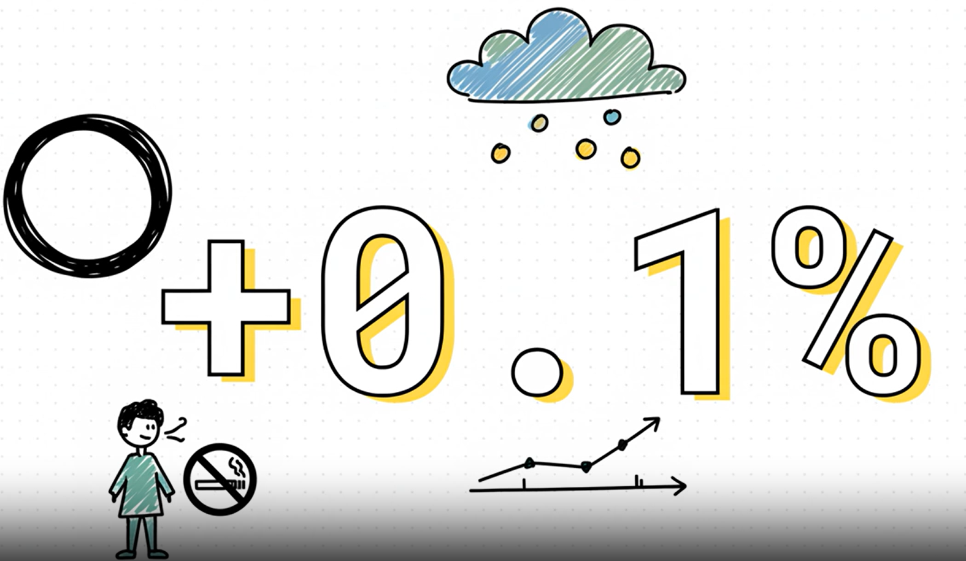
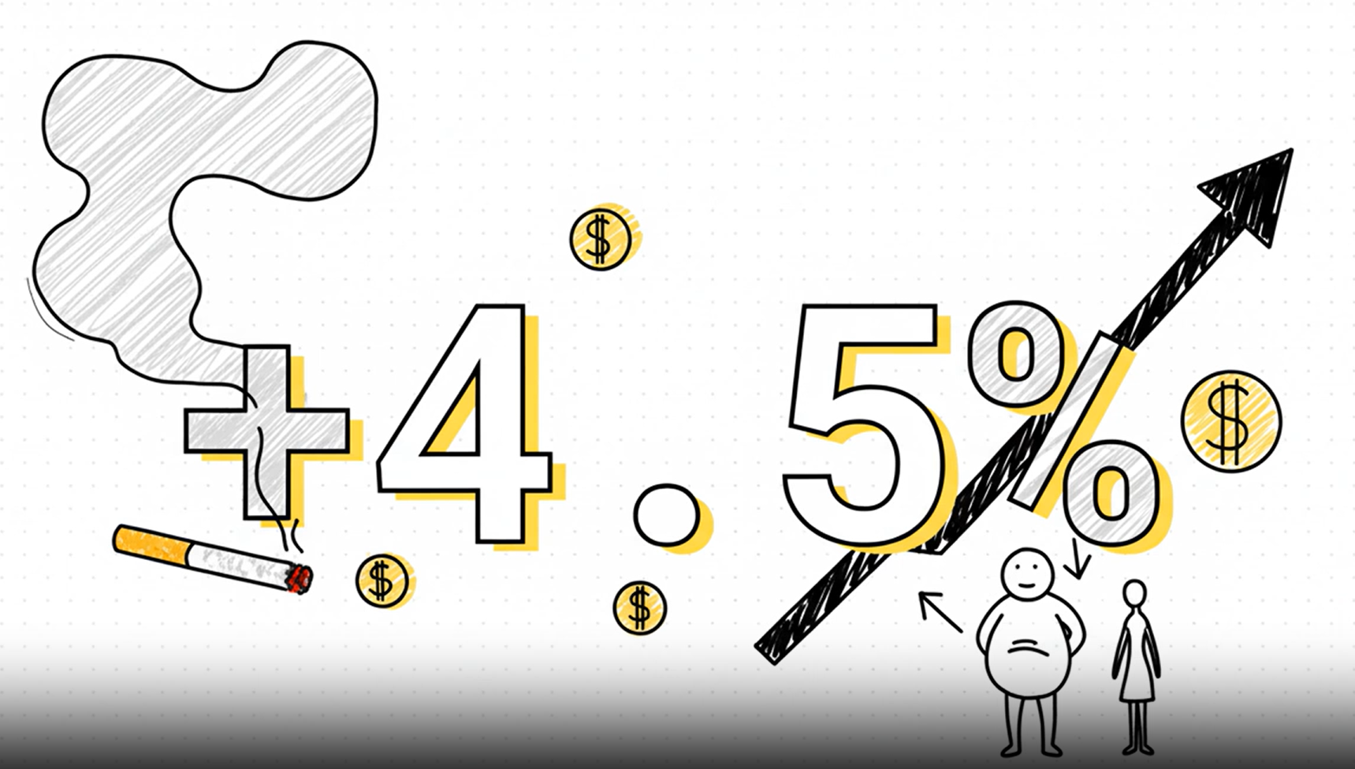
Conclusion & Implications
Limitations:
Cross-sectional data → associations, not causation.
Dataset does not include all real-world cost drivers (e.g., chronic conditions).
Mild curvature remains; additional nonlinear terms could improve future models.
Implications:
Differential pricing for high-BMI smokers
Strong support for smoking cessation programs
Key findings:
Useful for insurers, policy makers, and consumers
Smoking is the strongest cost driver
BMI strongly increases charges only for smokers
Non-smokers show almost no BMI effect
Log-transform produces a valid, interpretable model

Slide 18
Reference
Metropolitan State University. (2025). STAT 311: Regression Analysis (Fall 2025). Kaggle. Health Insurance Charges Dataset. Nalisha https://www.kaggle.com/datasets/nalisha/health-insurance-charges-dataset.

Slide 19


Thank you!
Q&A
we'd be happy to answer your questions!
Details please visit Feifei & Izzy’s Github:
https://github.com/fayfaycn/Stat-311-Final-Project-.git
https://github.com/izzyvmika/STAT311-50_Final-Project.git

